Slide 1
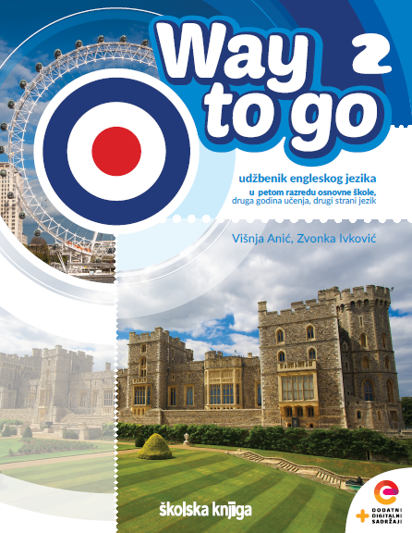

UNIT 2: Time for action
Clothes

Slide 2
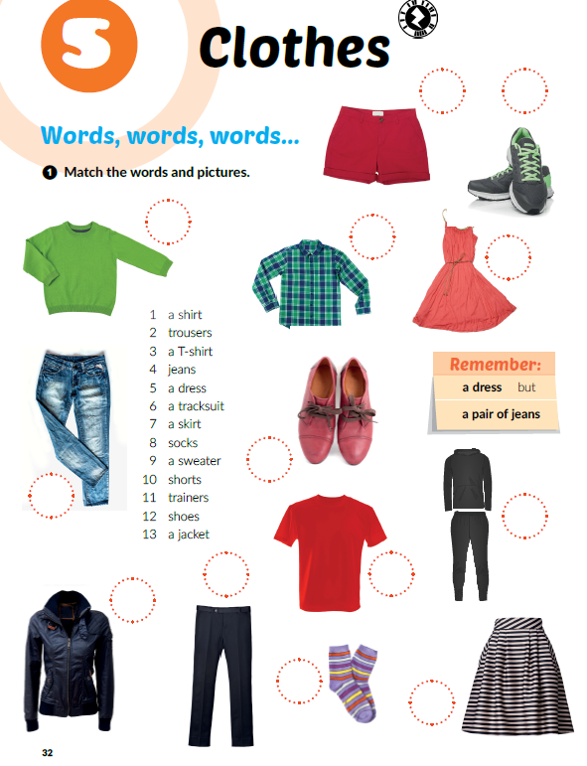
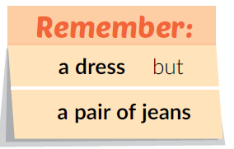
Clothes
10
11
What are you wearing today?
Which clothes is your favourite?
What do you have in your wardrobe?
What do you wear on your head / feet / neck…?
What do you wear in summer / winter?
9
1
5
12
4
6
2
3
13
8
7

Slide 3
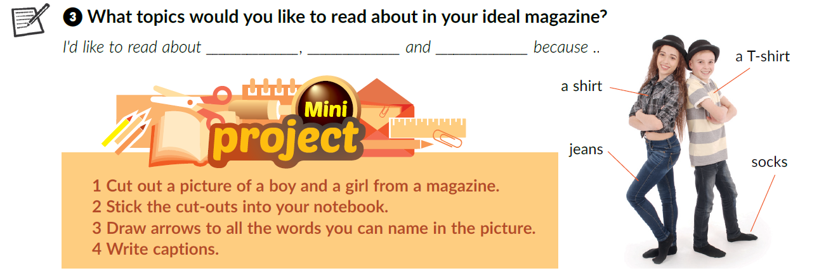

Project time
Click on the following link and choose ‘‘Play and learn: Guess who”
https://www.e-sfera.hr/dodatni-digitalni-sadrzaji/13d1b995-9428-49e8-a9d0-5f589fc36c28/

Slide 4
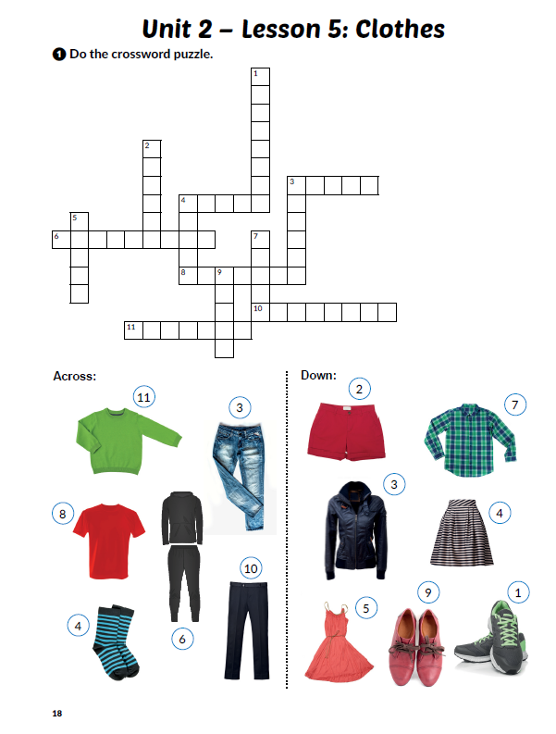
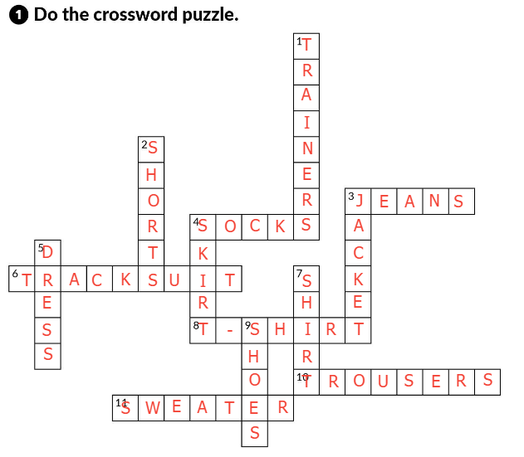
workbook p. 18

Slide 5
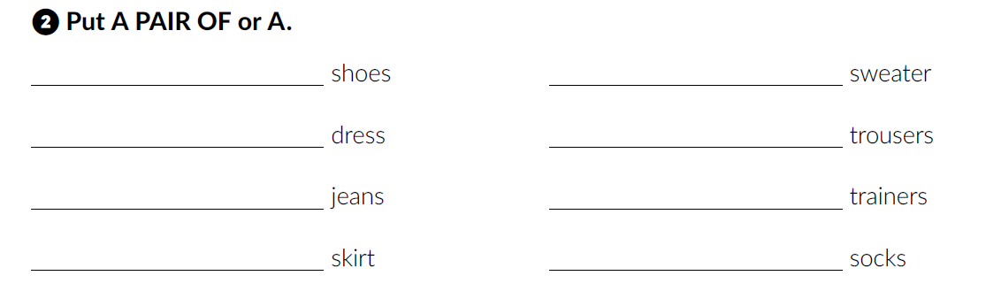
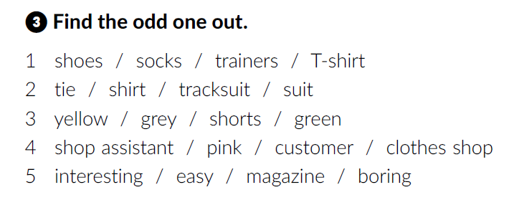
a pair of
a
a
a pair of
a pair of
a pair of
a
a pair of
Workbook, p. 19

Slide 6
Self check
https://www.e-sfera.hr/dodatni-digitalni-sadrzaji/13d1b995-9428-49e8-a9d0-5f589fc36c28/
Look at the PowerPoint presentation Clothes – reveal the picture

Slide 7
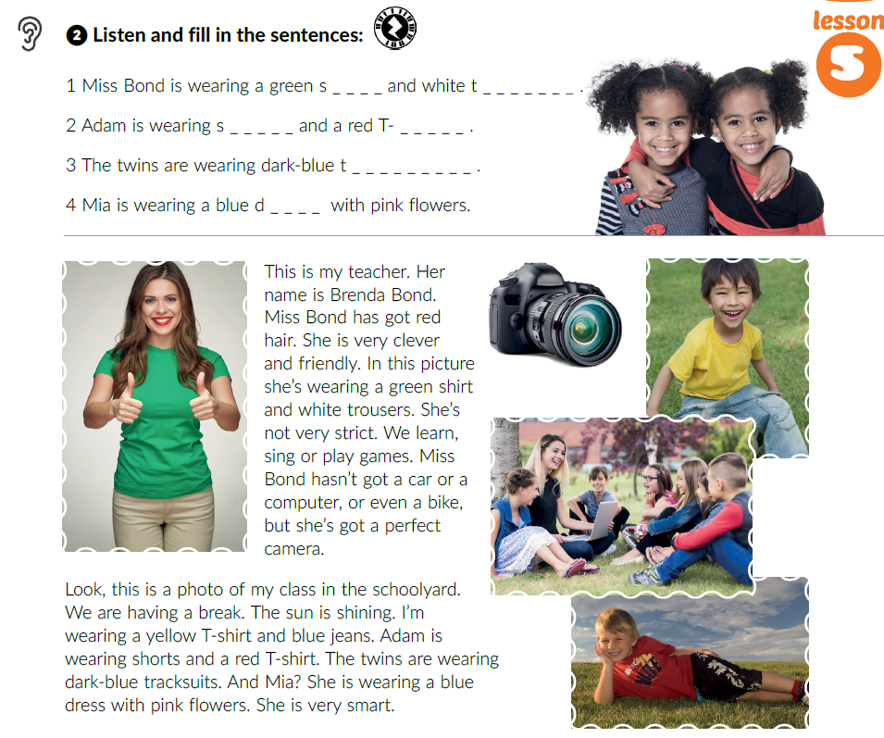

hirt
rousers
horts
shirt
racksuit
ress
What are they wearing?
What do they look like?
Listen and fill in the sentences (Task 2).

Slide 8
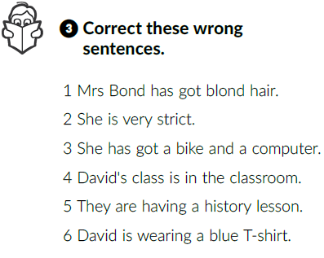
Listen again and correct the sentences.
Mrs Bond has got red hair.
She is friendly.
She has got a camera.
David’s class is in the schoolyard.
They are having a break.
David is wearing a yellow T-shirt.

Slide 9
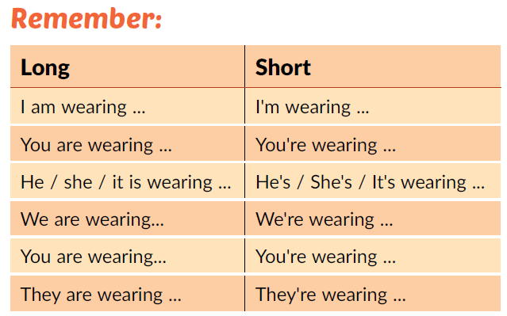
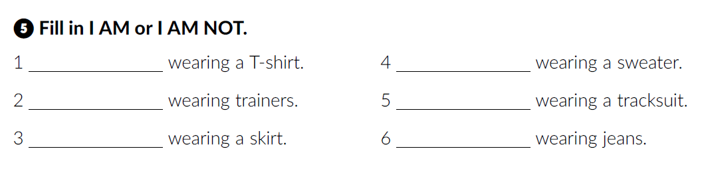
Look at the Remember box.
workbook p. 19/20.

Slide 10
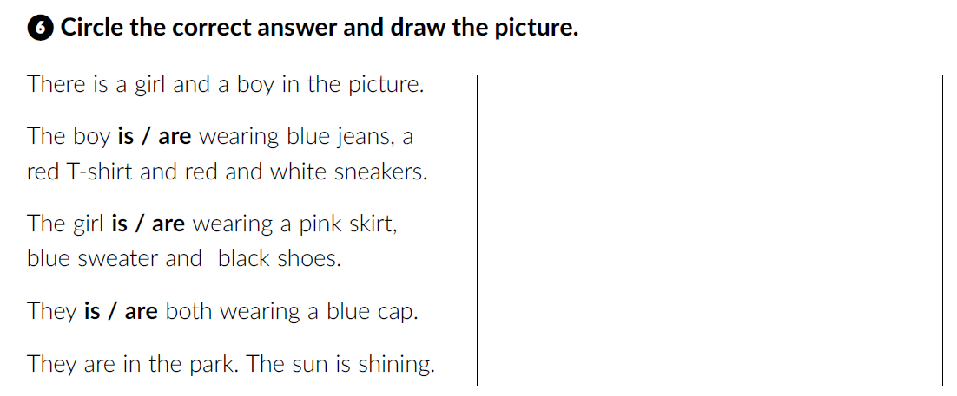
Go back to your book, page 32.

Slide 11
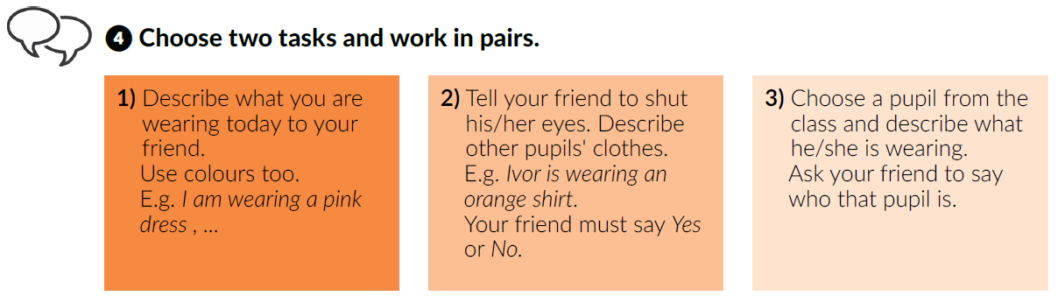
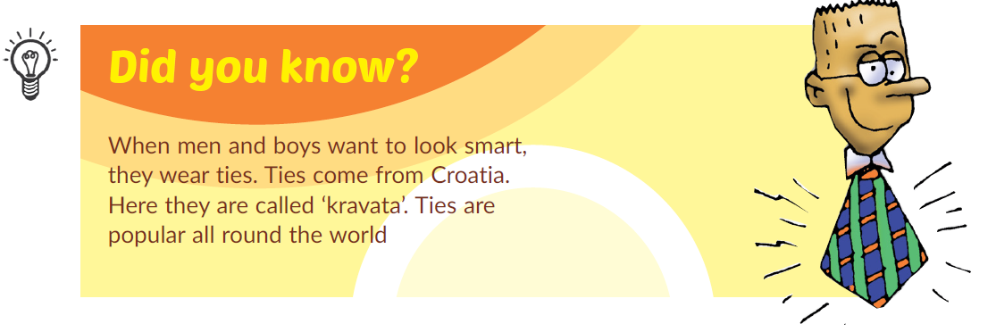
18 October – National Necktie Day

Slide 12
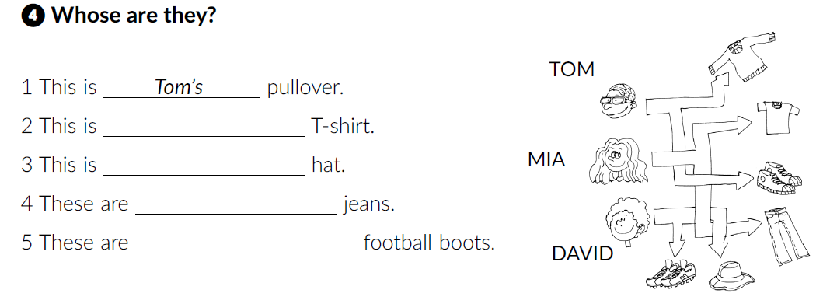
Workbook, p. 19
Mia’s
David’s
Mia’s
David’s
What is your favourite clothes store?
How often do you go shopping?
Do you like it?
Who do you shop with?

Slide 13
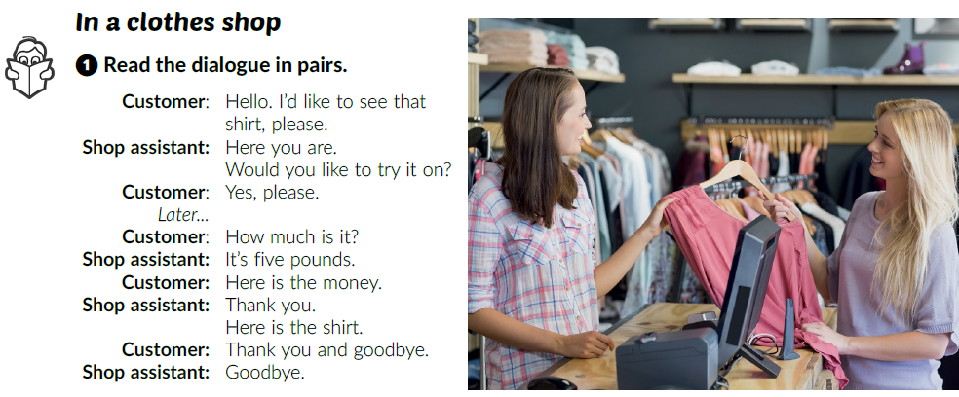
Do you know what these words mean?
Shop assistant Customer
What is the woman in the picture buying?
Which one is the shop assistant?
Which one is the customer?
Read the text and count. How many times are the following words mentioned in the text?
Please Thank you
prodavač
kupac
Two times.
Two times.
What does the word pound mean?
It is the British currency. (pound = funta)
Read the dialogue out loud.

Slide 14
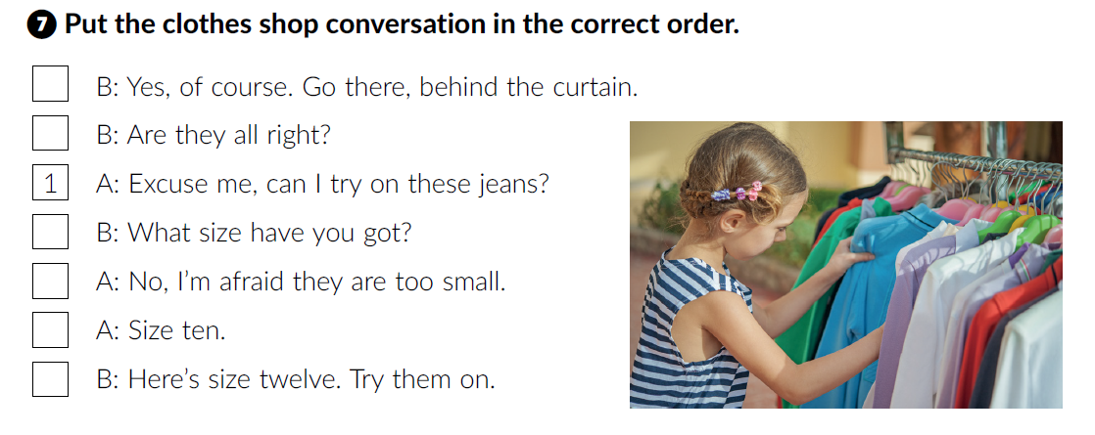
Workbook p. 20
2
3
5
4
6
7
What do these words mean?
curtain =
try on =
size =
zastor
isprobati
veličina

Slide 15
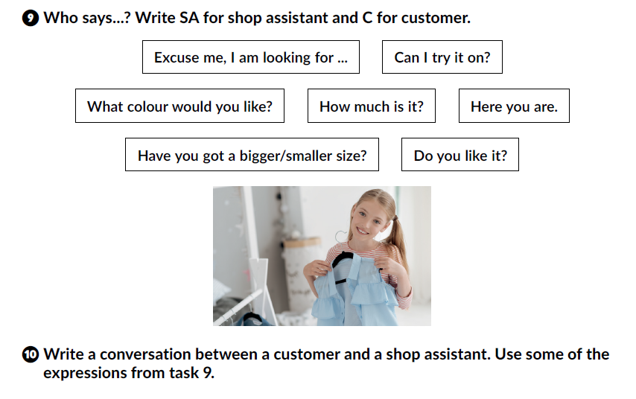
Work in pairs. Use the expressions from task 9 and write a conversation between a shop assistant and a customer.

Slide 16
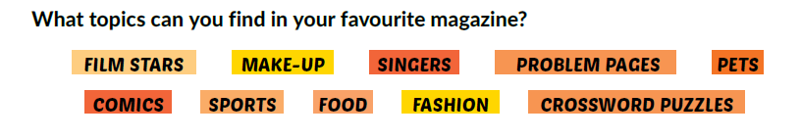
What can you buy at the newsagent’s?
What can you read and look at the pictures at the same time?
What can you flick through in a waiting room?
Where can you find articles about celebrities?
Magazines.
Open your book at page 34. Circle.

Slide 17
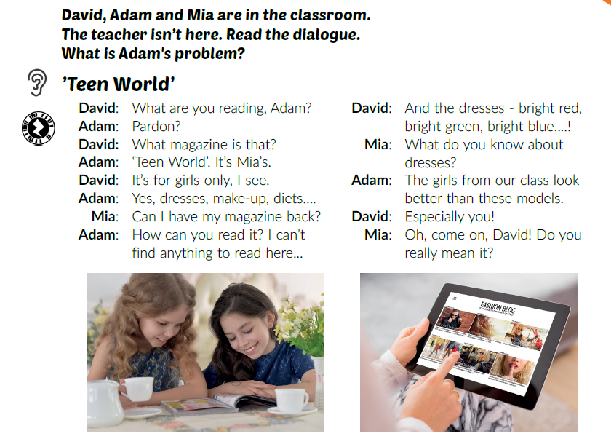
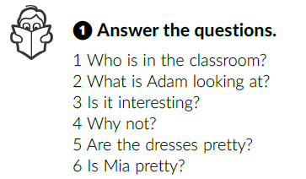
Listen. What is Adam’s problem?
He can’t find anything to read in Mia’s magazine.
Listen again and answer the questions.
1 Mia, Adam and David.
2 The ‘Teen World’ magazine.
3 No, it isn’t interesting to the boys.
4 Because it is for girls.
5 Yes.
6 Yes.

Slide 18
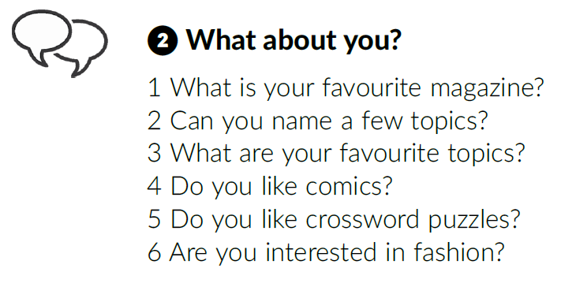
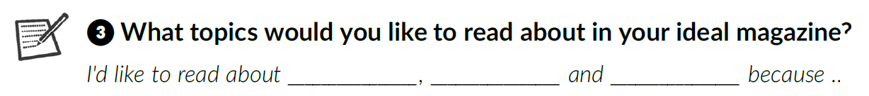
What about you?
Read the dialogue out loud.

Slide 19
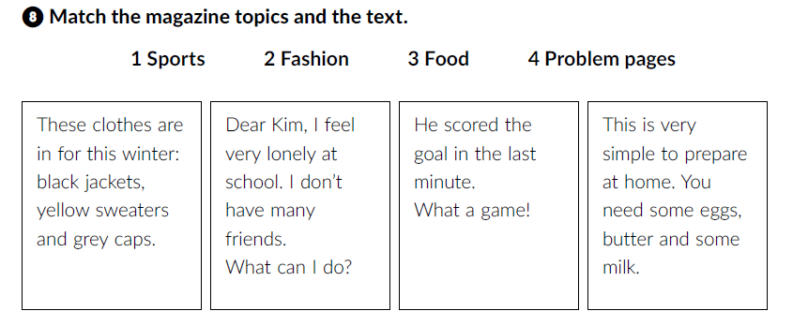
Click on the following link and choose Learn more: What’s in magazine: Beyonce. Complete the tasks.
https://www.e-sfera.hr/dodatni-digitalni-sadrzaji/13d1b995-9428-49e8-a9d0-5f589fc36c28/
workbook p. 20
Fashion
Problem pages
Sports
Food

